Slide 1

RecipEz
Team Members – Tamer Alorfahli
Project Advisor - Brett Spilka

Slide 2
Goals
Learn
Learn to utilize new tools, languages and frameworks
SWE Process
Go through full stack web dev process to create an application
Help
Help users get into a healthier and cheaper dietary lifestyle

Slide 3
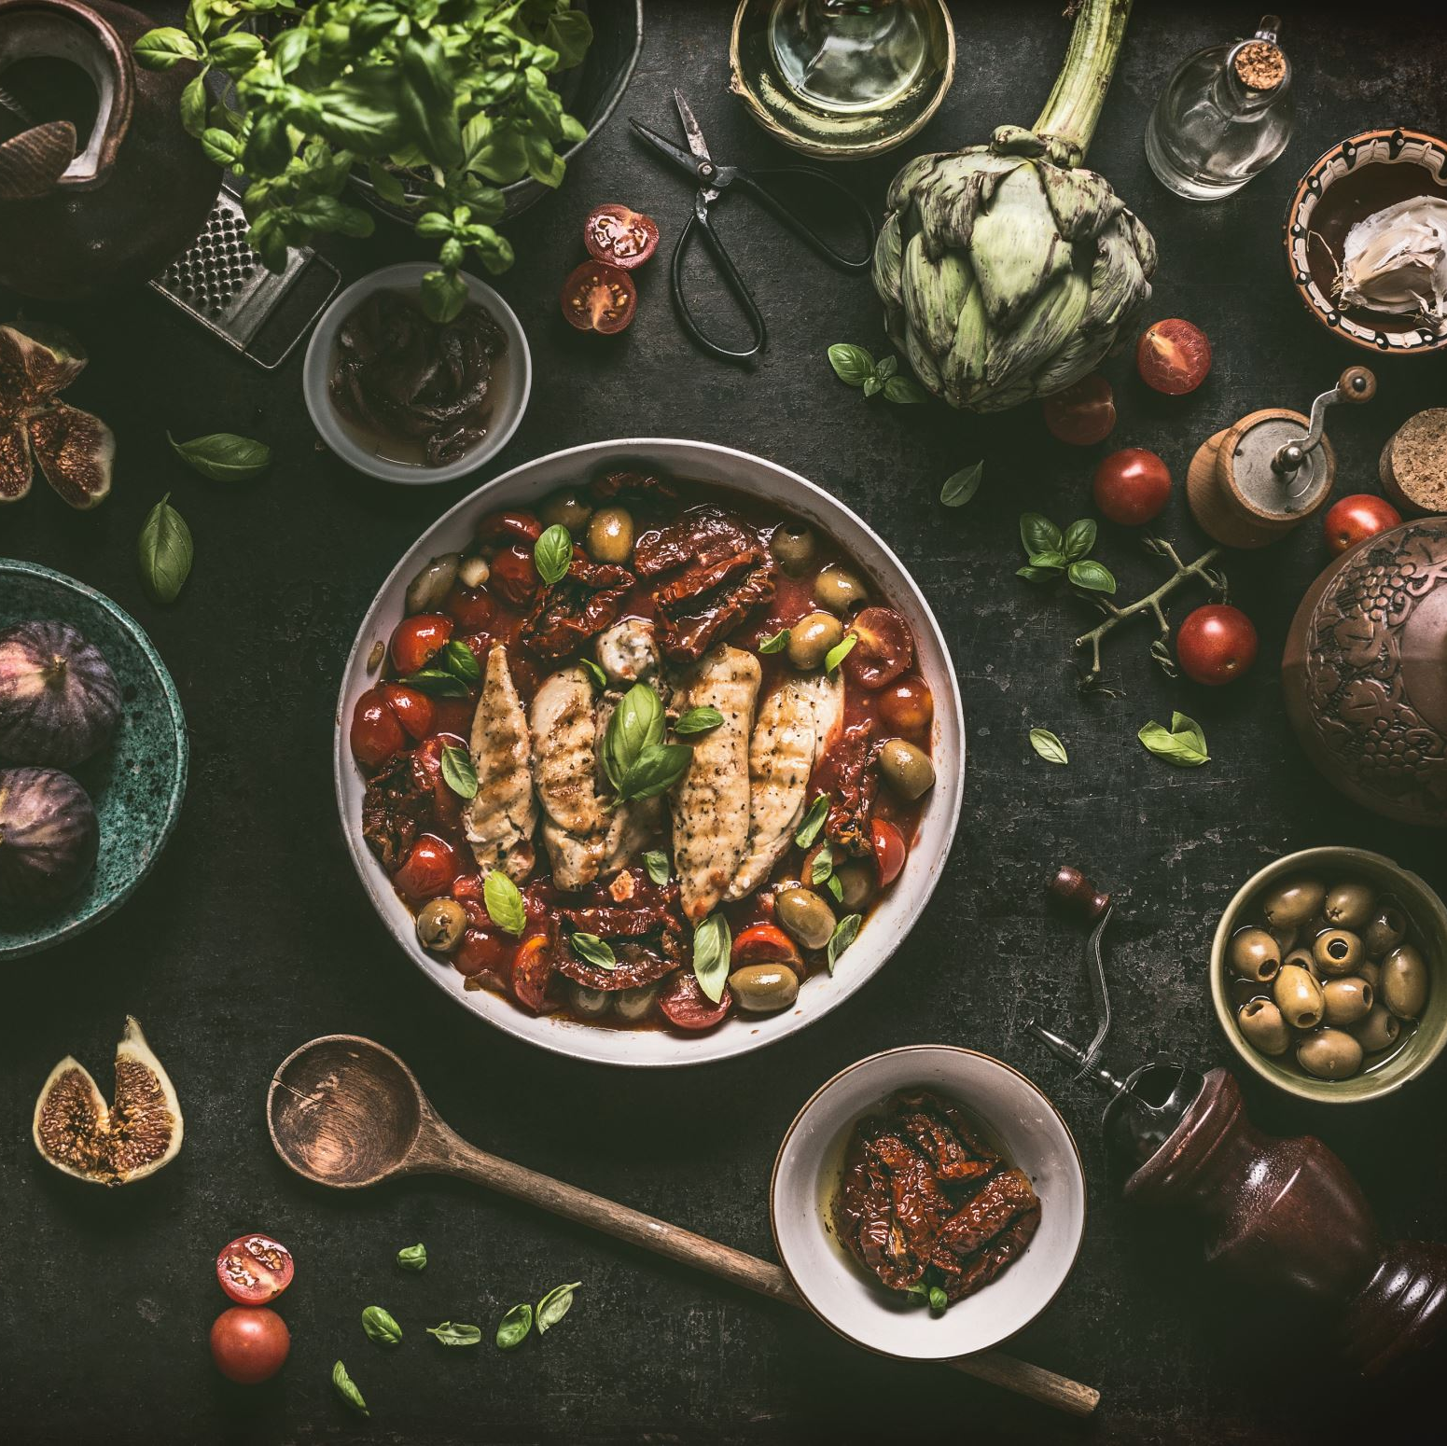
Intellectual Merits
The use of AI to help generate recipes for the user within the application.
The ability to keep clicking and randomly generate a dish until you find one you are satisfied with.
The possible integration of having the ingredients of the dish chosen purchased with a single button and then delivered to your home.

Slide 4

Broader Impacts
This application will help users by giving them more variety in their diet.
Push them to cook more often at home which will provide many benefits such as having cheaper meals, eating out less and teach them essential cooking skills.
With the bonus of helping them in the kitchen when a dietary restriction or change to a recipe is needed which can be tackled by the AI recipe generator.
Lead to potentially having less food waste.

Slide 5
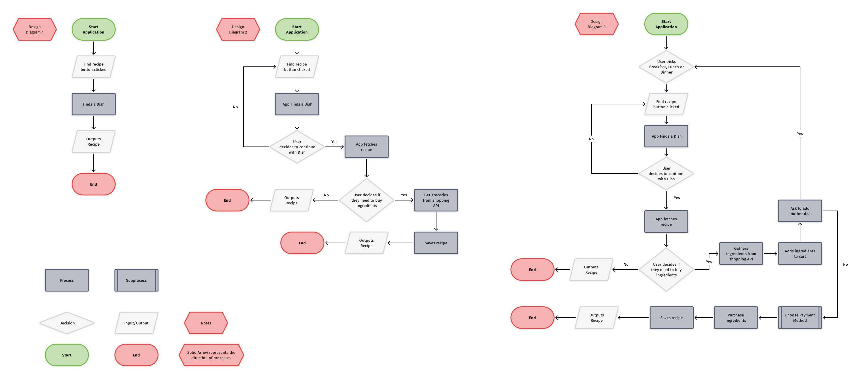
Design Specifications

Slide 6






Technologies
The project will implement one of three front end web dev tools being either the HTML stack, Native Swift, or Flutter.
The HTML stack will use HTML, CSS, and JS with the styling component being implemented via tailwind components to allow a cleaner code for readability and more features.
The Swift code will be mainly for IOS, IpadOS, and MacOS devices which will be limited to Apple but will have great performances and the development process with XCode would be nice.
Finally, the Flutter process will be multi-platform but would be hard as it is mainly built with many widgets and doesn’t seem as easy to implement as the other stacks.
There will also be the use of different APIs such as the RecipeAPI as well as the OpenAI API to add functionality to the application for recipe and dish generation.
Finally, there will be an account creation process which will implement the Firebase technology for account authentication, signup and login, as well as real time database.

Slide 7

Milestones
Research
Do more research for implementation finish by March 3.
Front end
Implement the design in code by March 10.
Back-end
Implement the back-end code and APIs by March 17.
Documentation
Document anything needed for personal and presentable reasons, will be ongoing.
Misc. and Errors
Finish any final touches up by March 30.

Slide 8
Results
The front end has 2 designs, and the final draft will be implemented depending on the technology used.
The APIs have been narrowed down and some final testing with them are being made to determine best ones to use.
The back-end language is still being determined with either a multiplatform Flutter application, Native Swift app or a web app using HTML,CSS,JS will be chosen.
There are two draft applications made those being the ones implementing Swift as well the Flutter design, the web app is in progress and the best one of the three will be chosen.

Slide 9
Challenges
Choosing the right tech stack and what platform.
Learning the different tools and tech stacks used.
Prioritizing the features that were able to be realistically implemented with the time provided
Integrating the different API’s
Limited documentation on some API’s and technologies

